Slide 1


Slide 2



monTree
Mihael Šandro Maria Cambalova Tiril Key Grimsrud
Karoline Meyer Jacobsen Zuzanna Dzialowska

Slide 3

concept
Notes:
• Who are we?
• Mission, vision, values

Slide 4
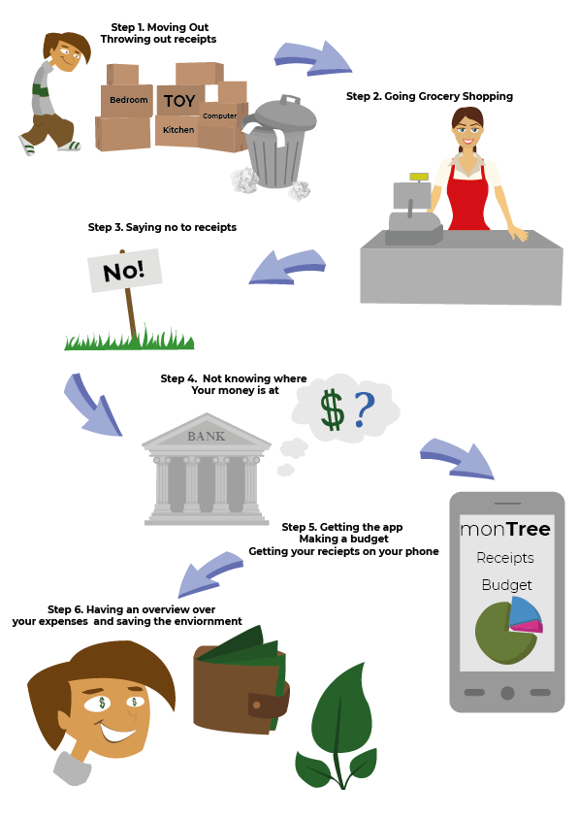
target audience
People who:
have a basic understanding of modern technology
have to manage their our budget
are busy with their professional duties and personal life
- are interested in eco-friendly actions
are having rich social life, so that they can promote the app via word of mouth marketing
Notes:
The customer is clearly confused about how the amount of money spend on groceries – the paper receipts are not helpful. He can download the monTree app and get a clear view on the budget AND save the environment by not having the receipt printed out.

Slide 5
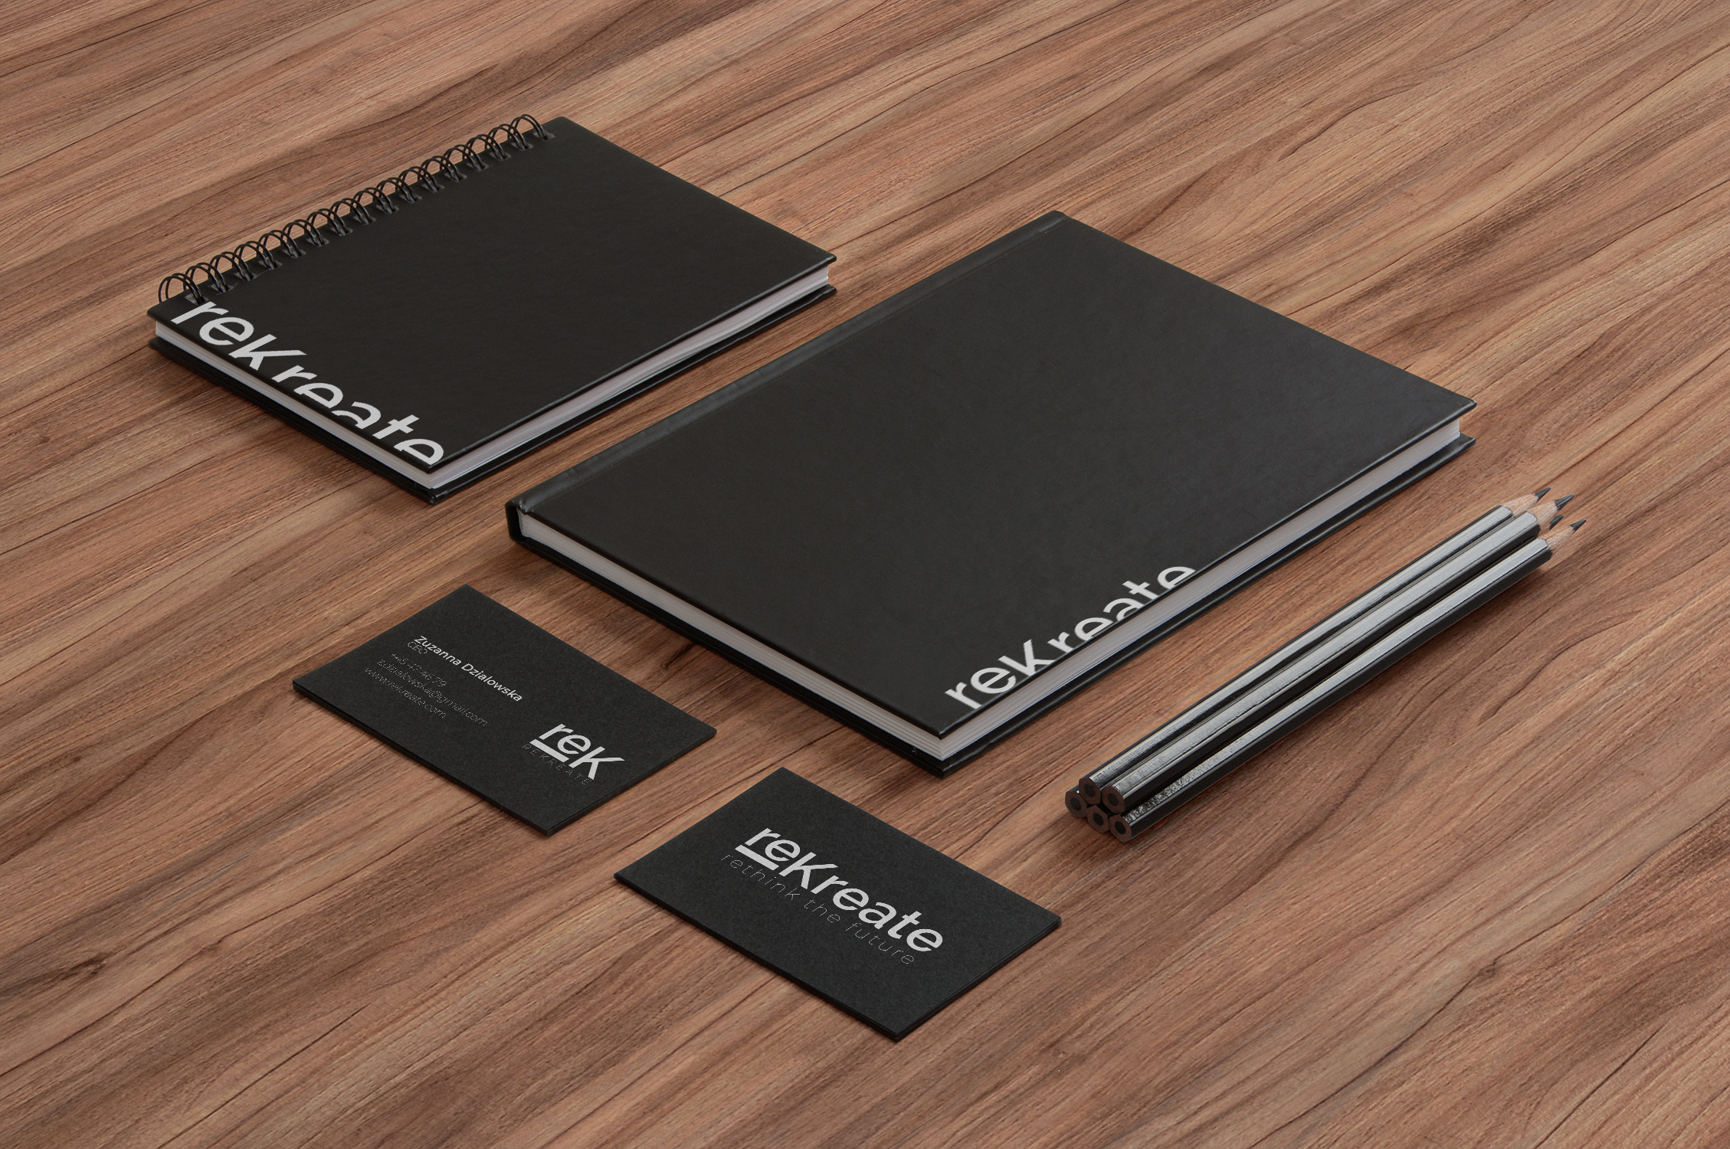
visual identity

Slide 6




Notes:
Same, except for colors and typography
• the choice of the name of the agency and app

Slide 7

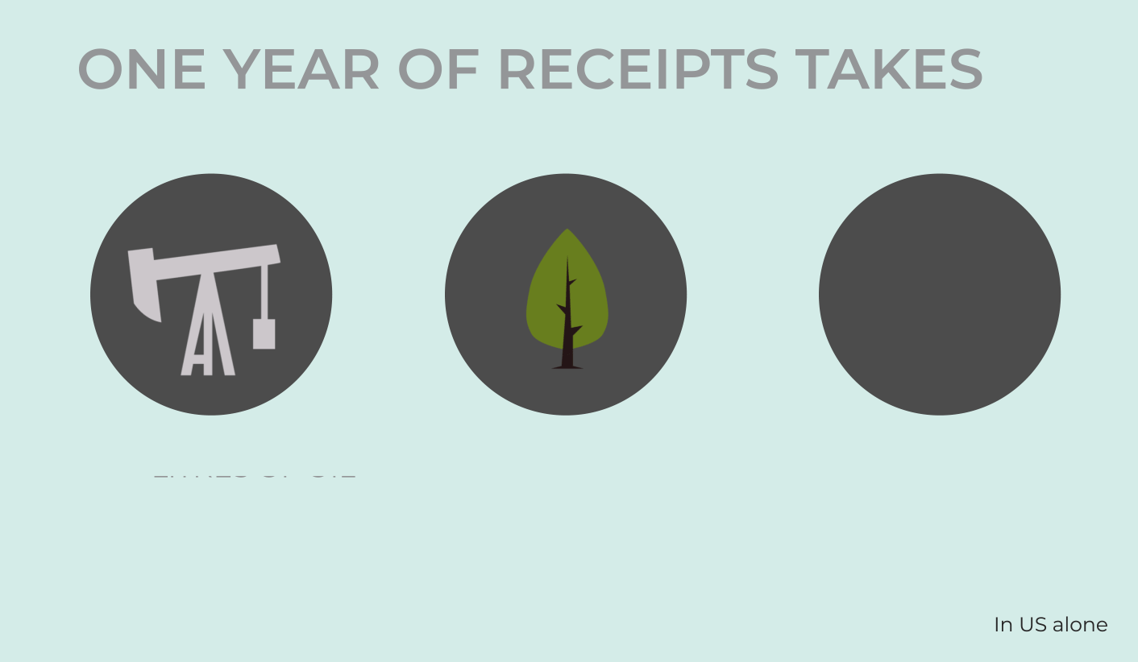
Notes:
Environmental impact

Slide 8

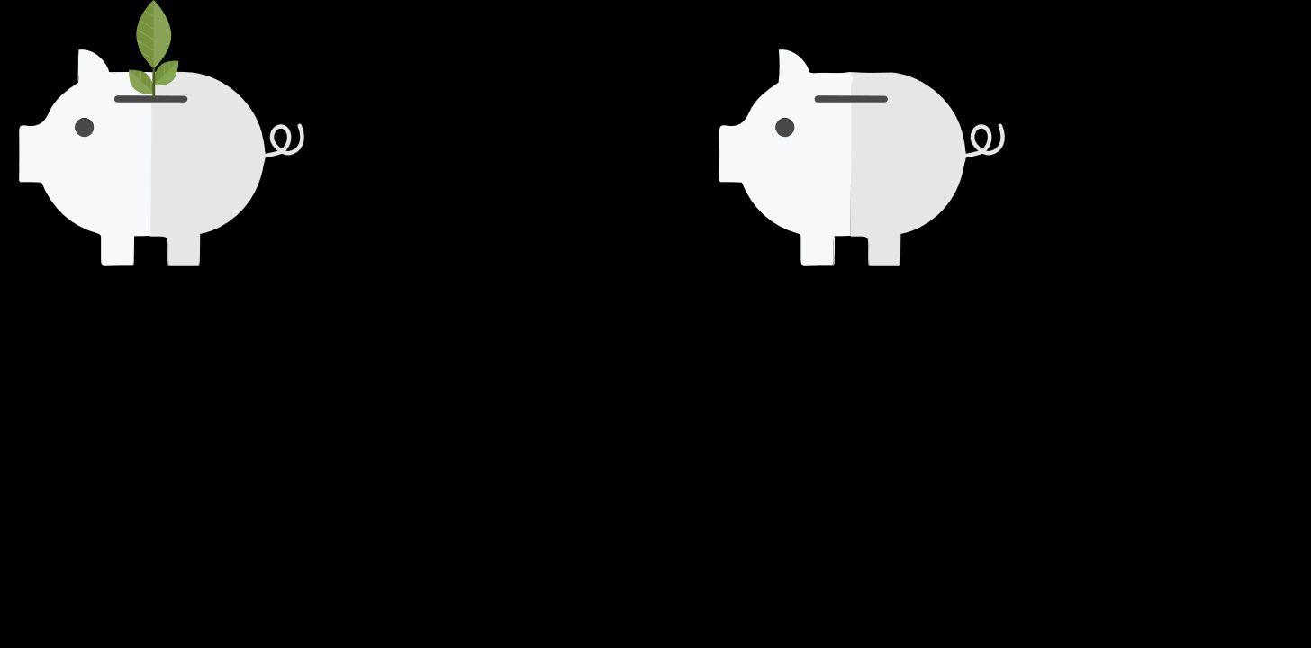


monTree
monTree
monTree
monTree
Notes:
Commenting the choice of colors
• what the logo represents
• typography

Slide 9
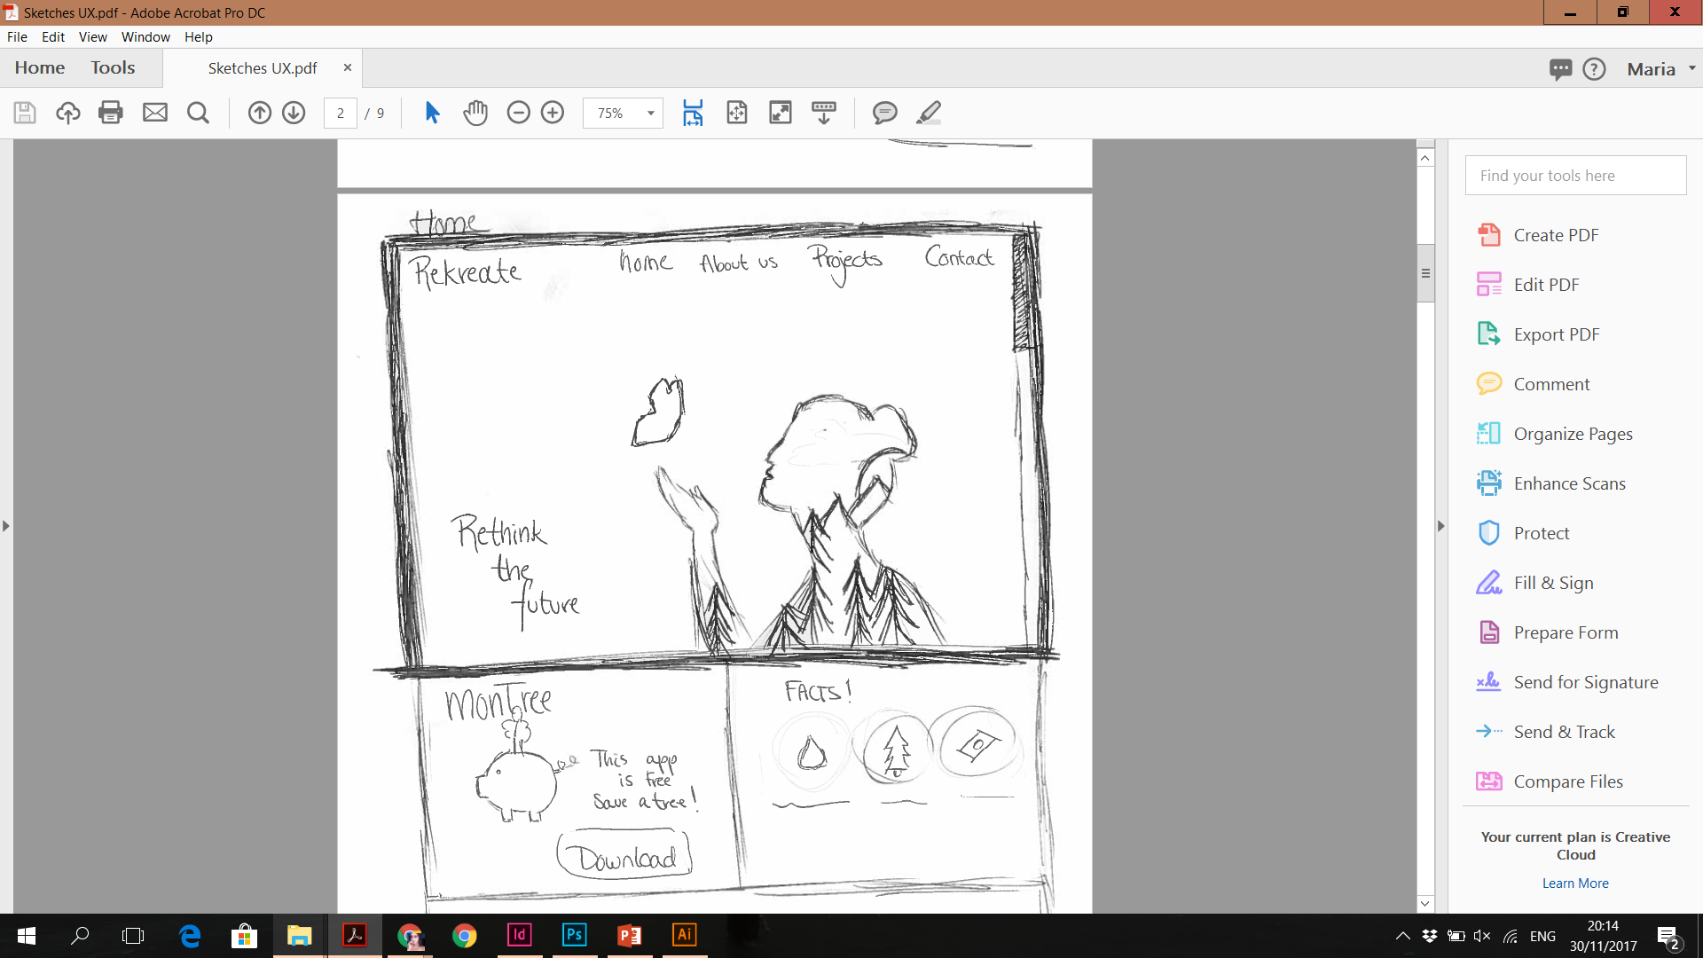
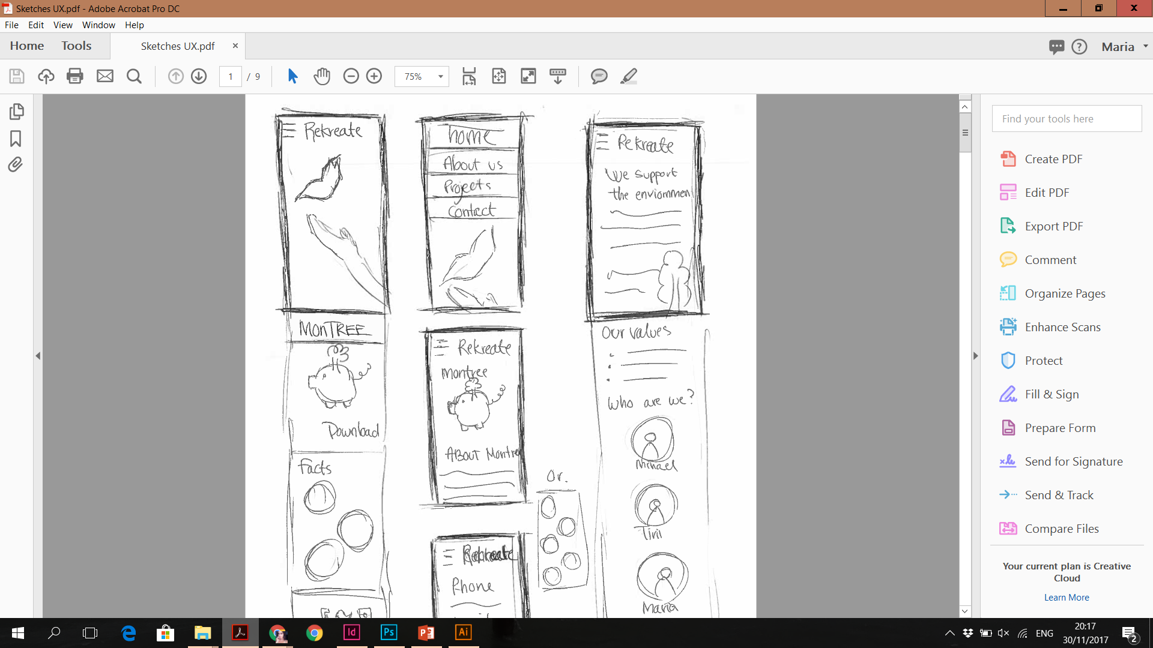
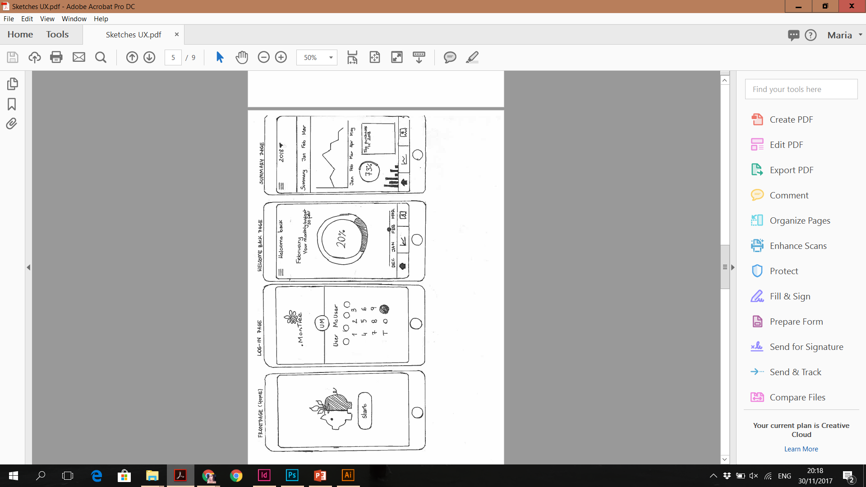
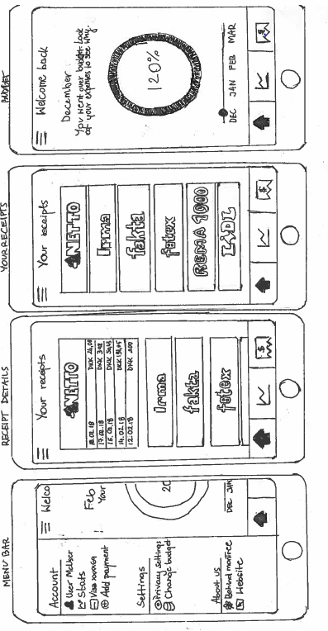
sketches
Notes:
• the development of the company‘s website and the app

Slide 10
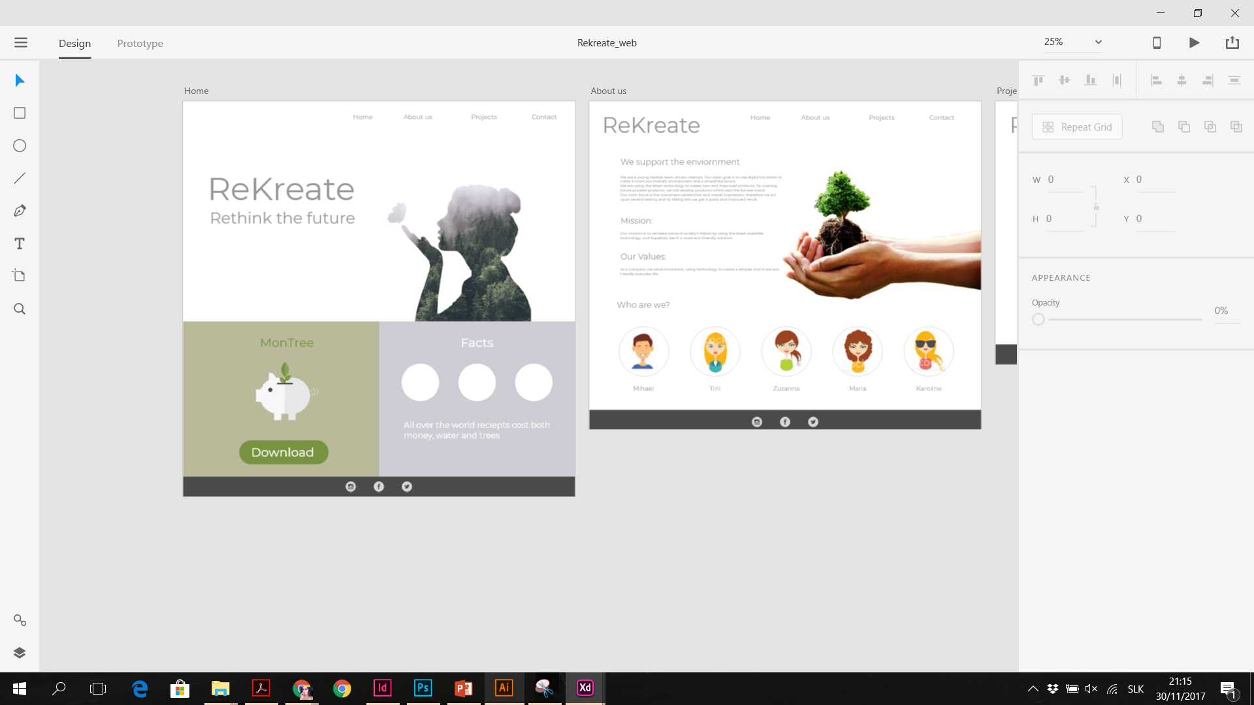
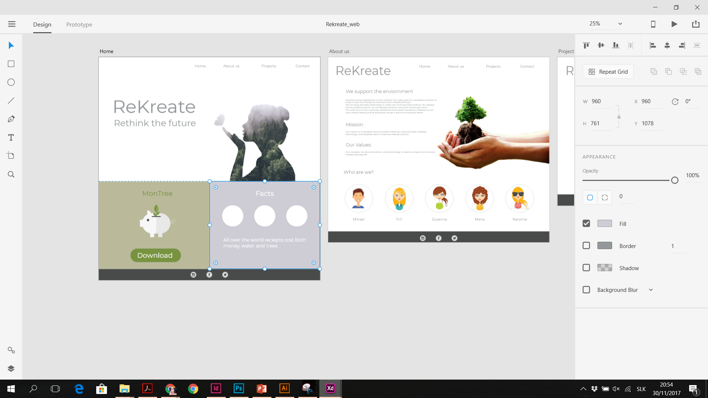
website prototype
Notes:
• development from sketches to XD prototype

Slide 11
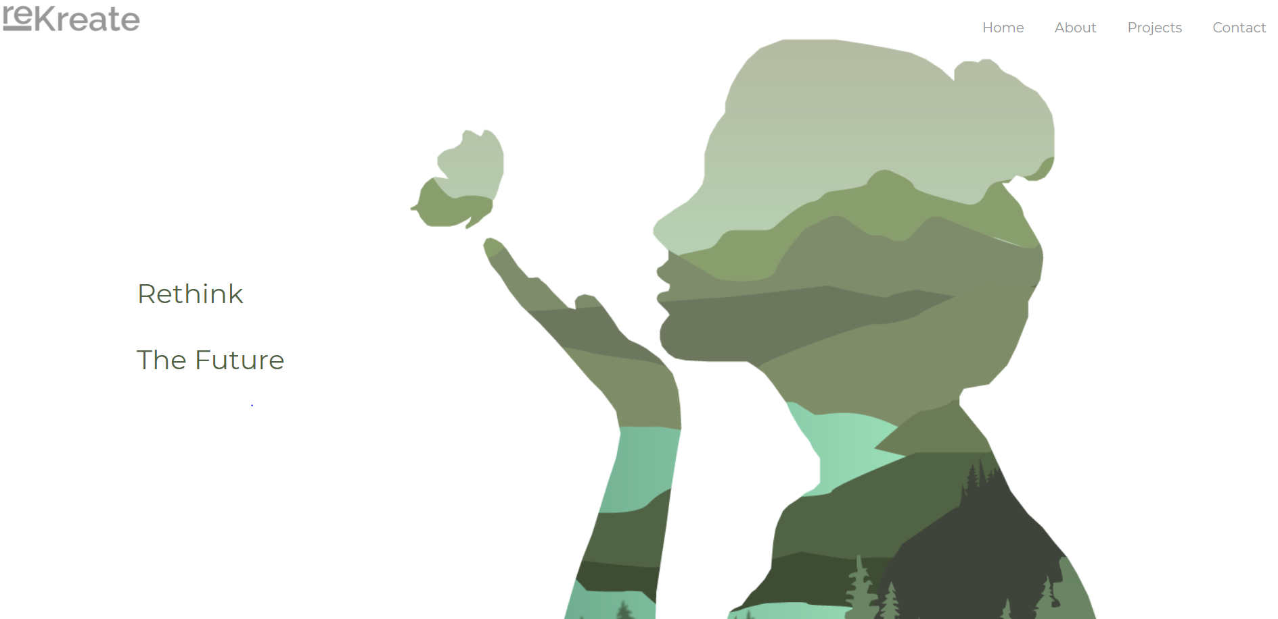
homepage
Notes:
• demonstration

Slide 12
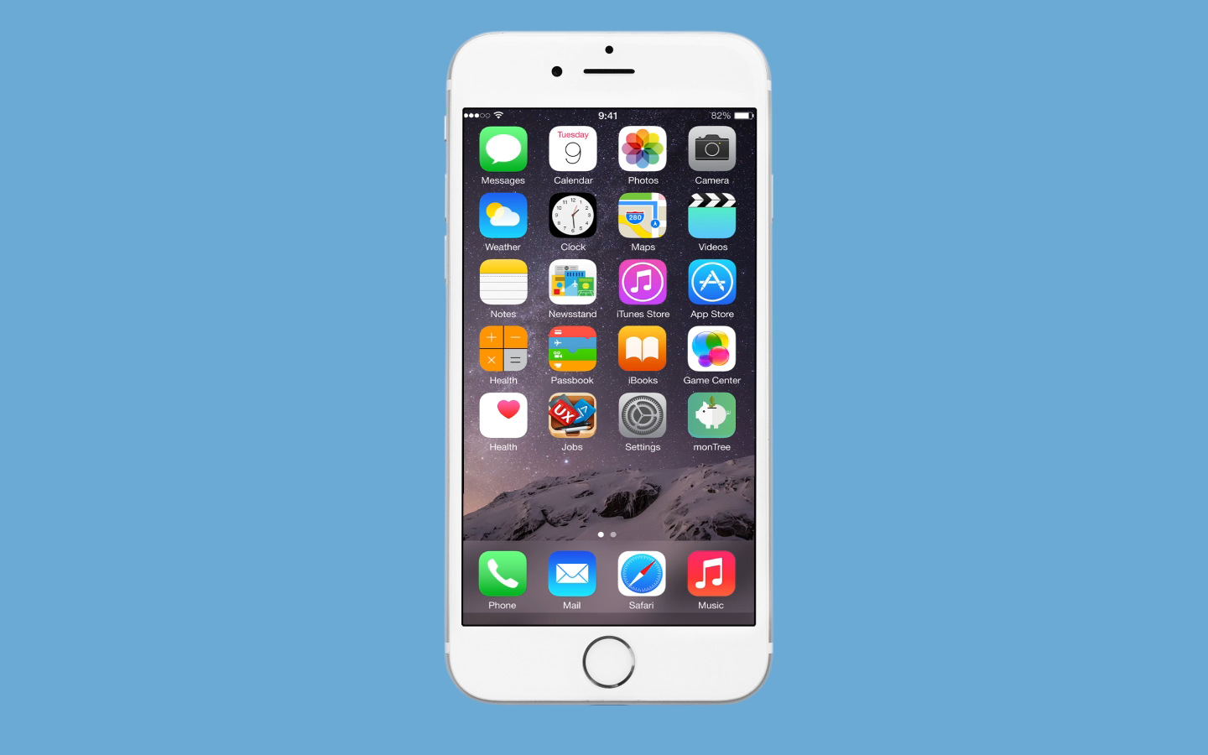
digital service

